Slide 1
TEAM INFORMATION
Team Name : Smart Waste Warriors
Team leader : ( Name ,Roll no, phone no ,Email , college )
Komati.Lahari ,Rollno:23b01a0459, phoneno:8797973399, Email:laharikomati11@gmail.com,college:shri vishnu engineering college for women
Team numbers ( Names & colleges)
Ch.C.S.L.Bhavani -shri vishnu engineering college for women
K.Kamala -shri vishnu engineering college for women
Ch.Kiran kumari-shri vishnu engineerinng college for women

Slide 2
Problem Statement
Problem Statement: Many cities face inefficient waste collection processes, leading to overflowing bins, increased pollution, and low recycling rates.
Understanding of the Problem : Many cities struggle with inefficient waste collection, overflowing bins, and low recycling rates. Traditional waste management systems operate on fixed schedules, often leading to delayed pickups, high operational costs, and increased pollution. Additionally, poor waste segregation results in more landfill waste and reduces recycling efficiency.
The lack of real-time monitoring and optimized waste collection makes it difficult to manage waste effectively, impacting urban cleanliness, sustainability, and public health

Slide 3
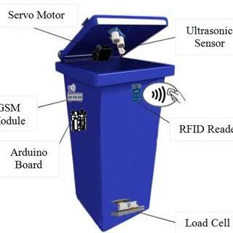
Solution Approach
IoT-Enabled Smart Bins – Sensors detect fill levels and alert collection teams.
AI-Based Route optimization-Reduces fuel costs and improves efficiency
Automated waste segregation-Al driven sorting enhances recycling
Citizen Engagement – Mobile app for waste tracking, complaints, and rewards.
Key Features:
Smart Bins
Waste tracking
Reduce fuel costs
Real time Reporting and monitoring
smart door operation
use friendly interface

Slide 4
Feasibility & Impact
Assumptions :IoT adoption will become more cost-effective with technological advancements.
Incentives will drive citizen participation in waste management
Governments and businesses will back smart waste initiatives.
Waste companies will adopt new technologies with proper training.
Feasibility & Implementation Extent
Financial Feasibility
infrastructure setup
scaling &monitoring
Future scope :waste prediction , automated recycling , smart composting , smart city integration

Slide 5
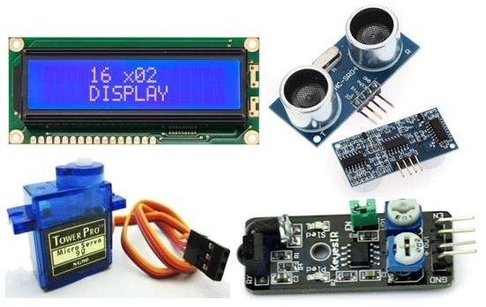
Requirements & Resources
Hardware: Arduino uno , Ultrasonic sensor,IR sensor,LCD,Servo motor ,Buzzer, Bug converter .
Software: Arduino c
APIs/Frameworks/Databases :
scalable ,real-time,and efficient waste management system!
External Dependencies :
effcient waste management and sustainability .

Slide 6
Conclusion
Smart waste management uses IoT for efficient collection ,sustainability in urban areas . with proper implementation, they can significantly reduce costs, pollution, and landfill waste, promote hygience, making cities cleaner and smarter!
Thank You !

